Slide 1
Star-Track
An AMNH Track the Stardust team

Slide 2
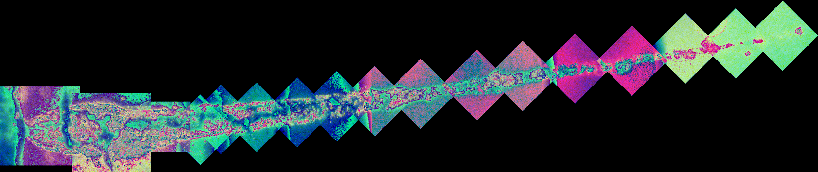
Overview
Pre-processing - Denoising 2D aerogel slice images
Analysis - Stacking 2D slices - Obtaining lateral and cross-sectional views of slices

Slide 3
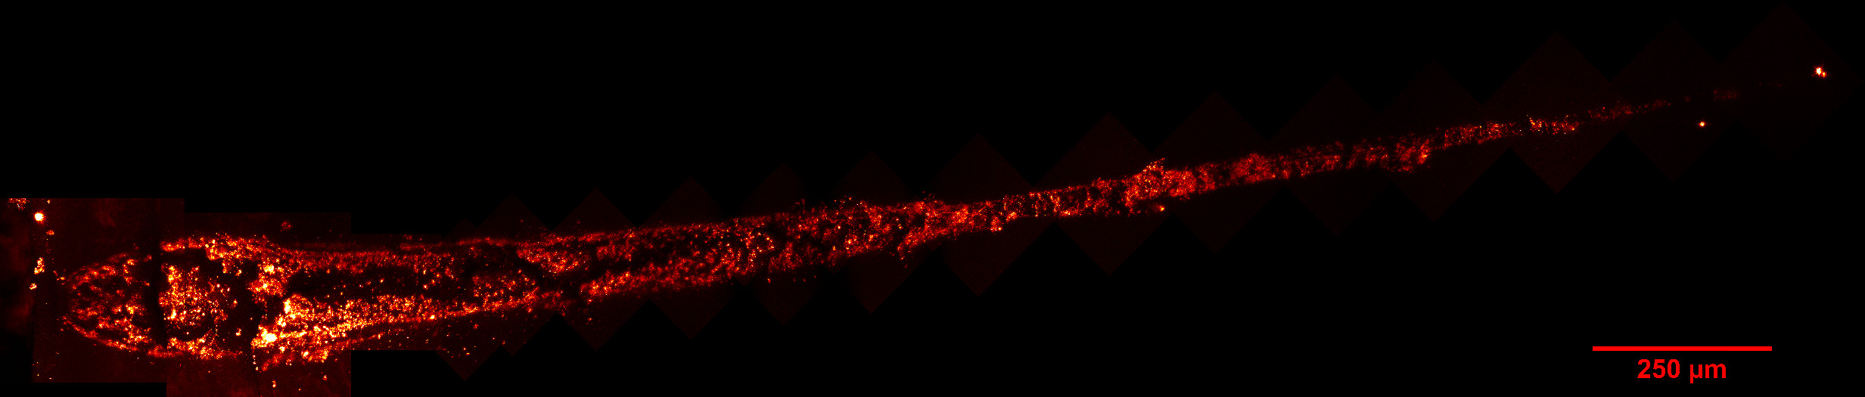
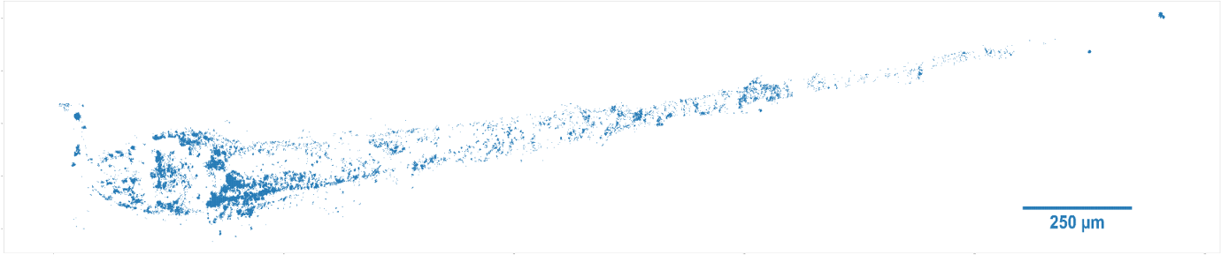
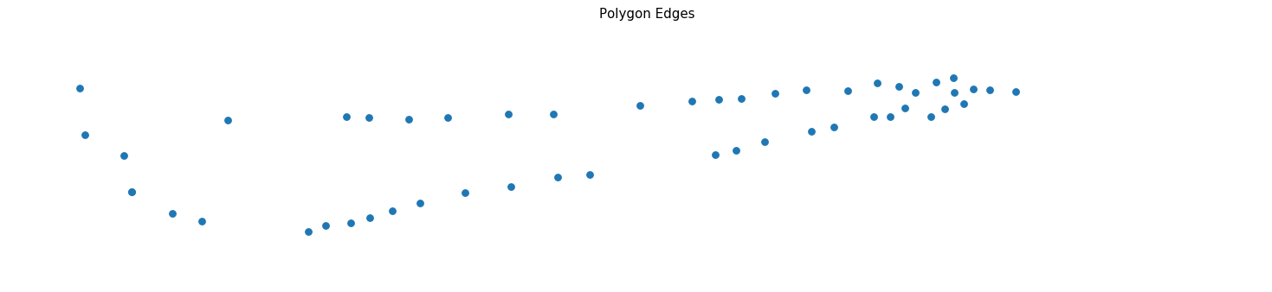
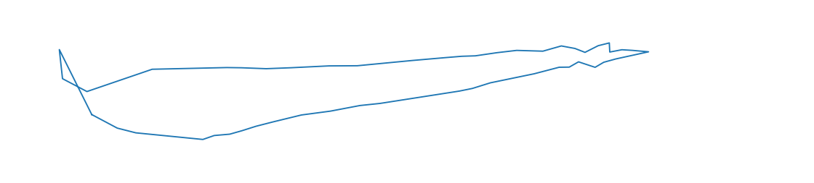
The Process:
Thresholding and denoising slices
Identifying and connecting the dots OR image stacking
Filling image outline
Measuring images

Slide 4
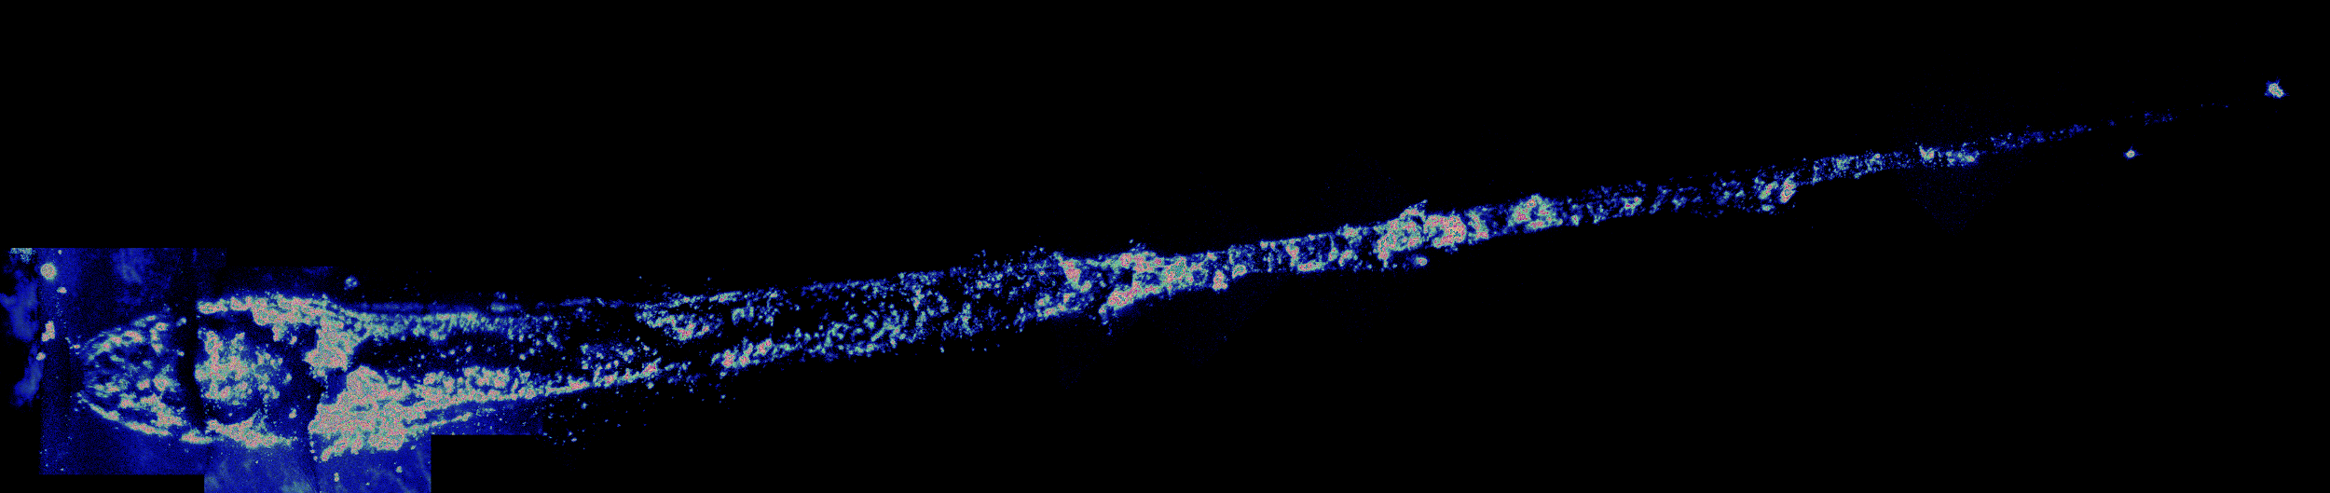
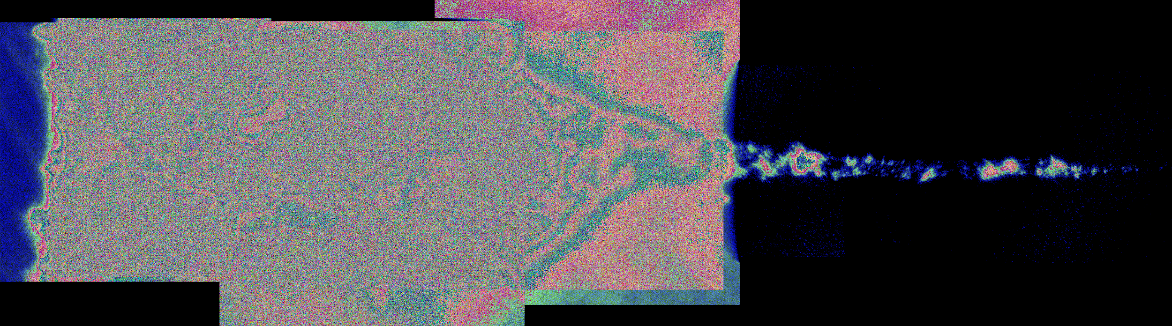
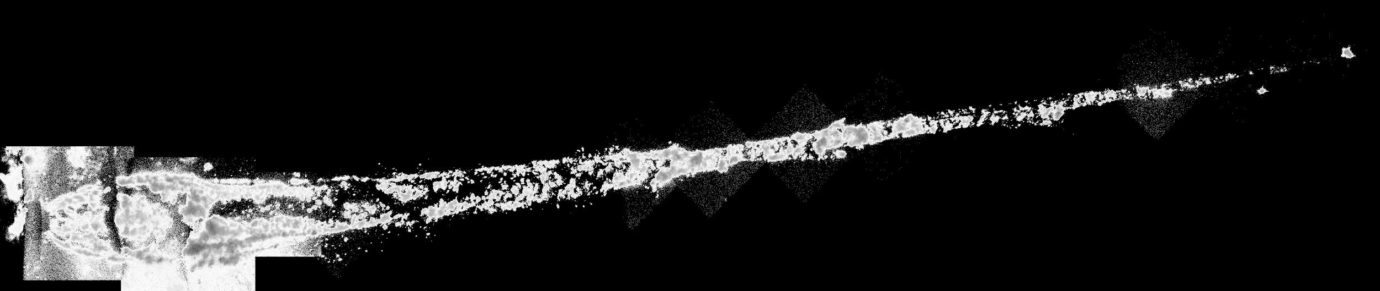
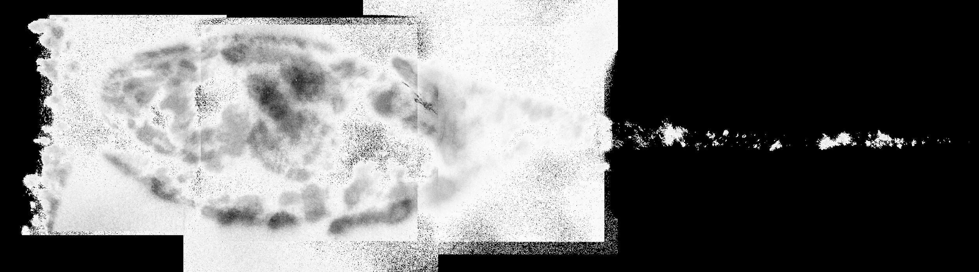
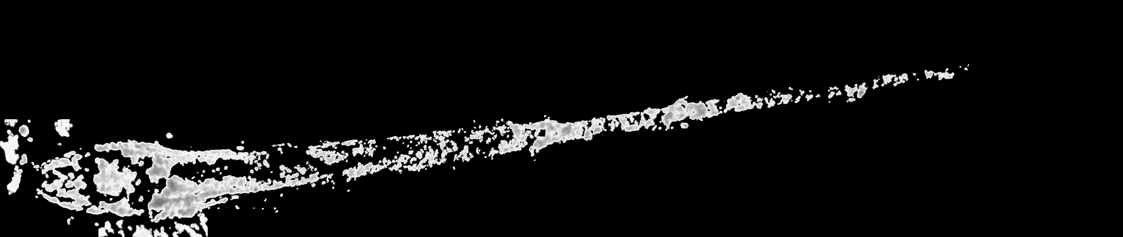
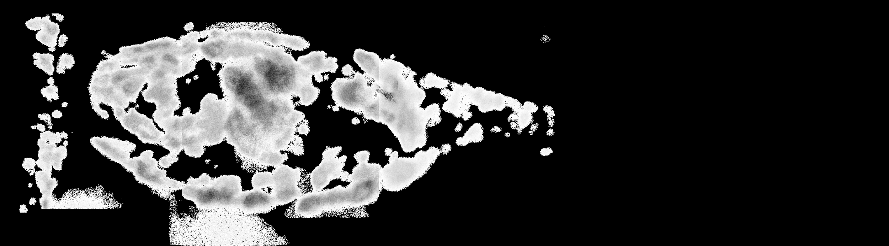
Three kinds of noise reduction
Notes:
Blue values
Concentration of single-channel blue-colored pixels in lefthand side of slices
Mean & standard deviation
Kept pixels within three stdevs above mean pixel value
Averaging over pixel neighborhood
Removed blocks of pixels with densities lower than 100p per 20px20p

Slide 5
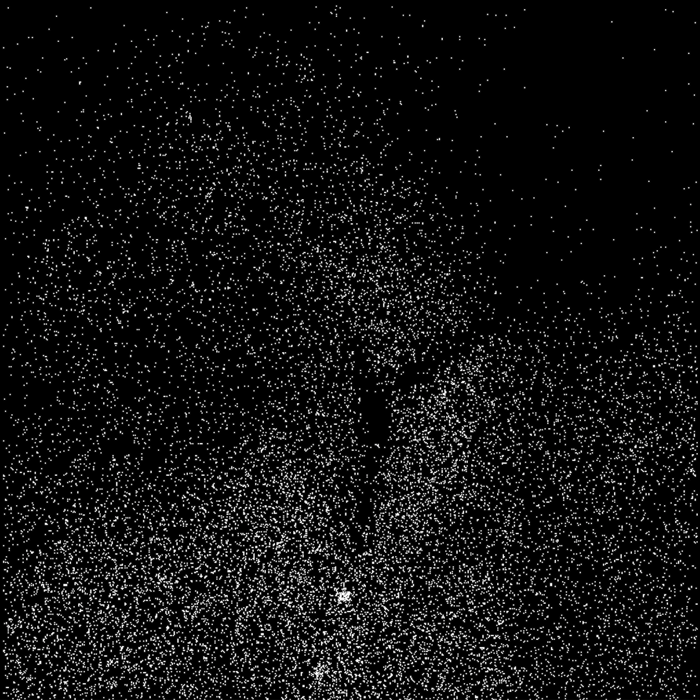
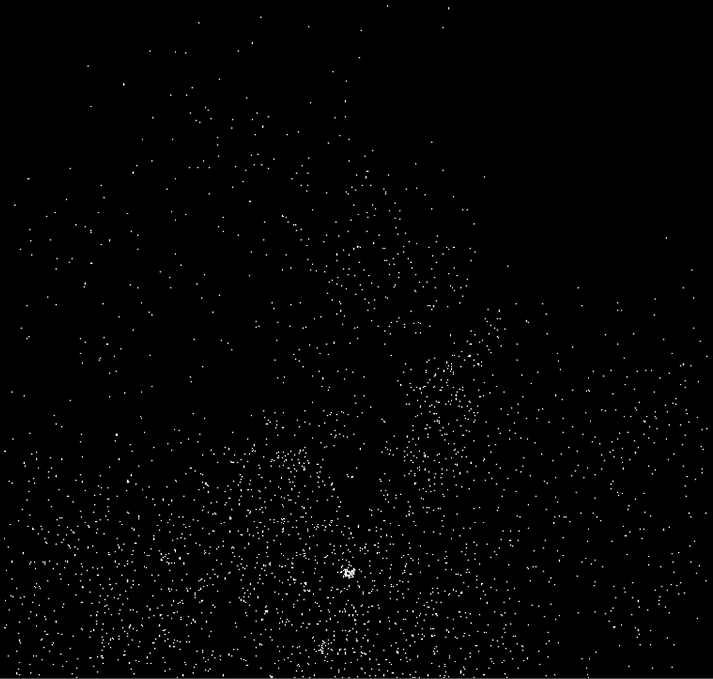
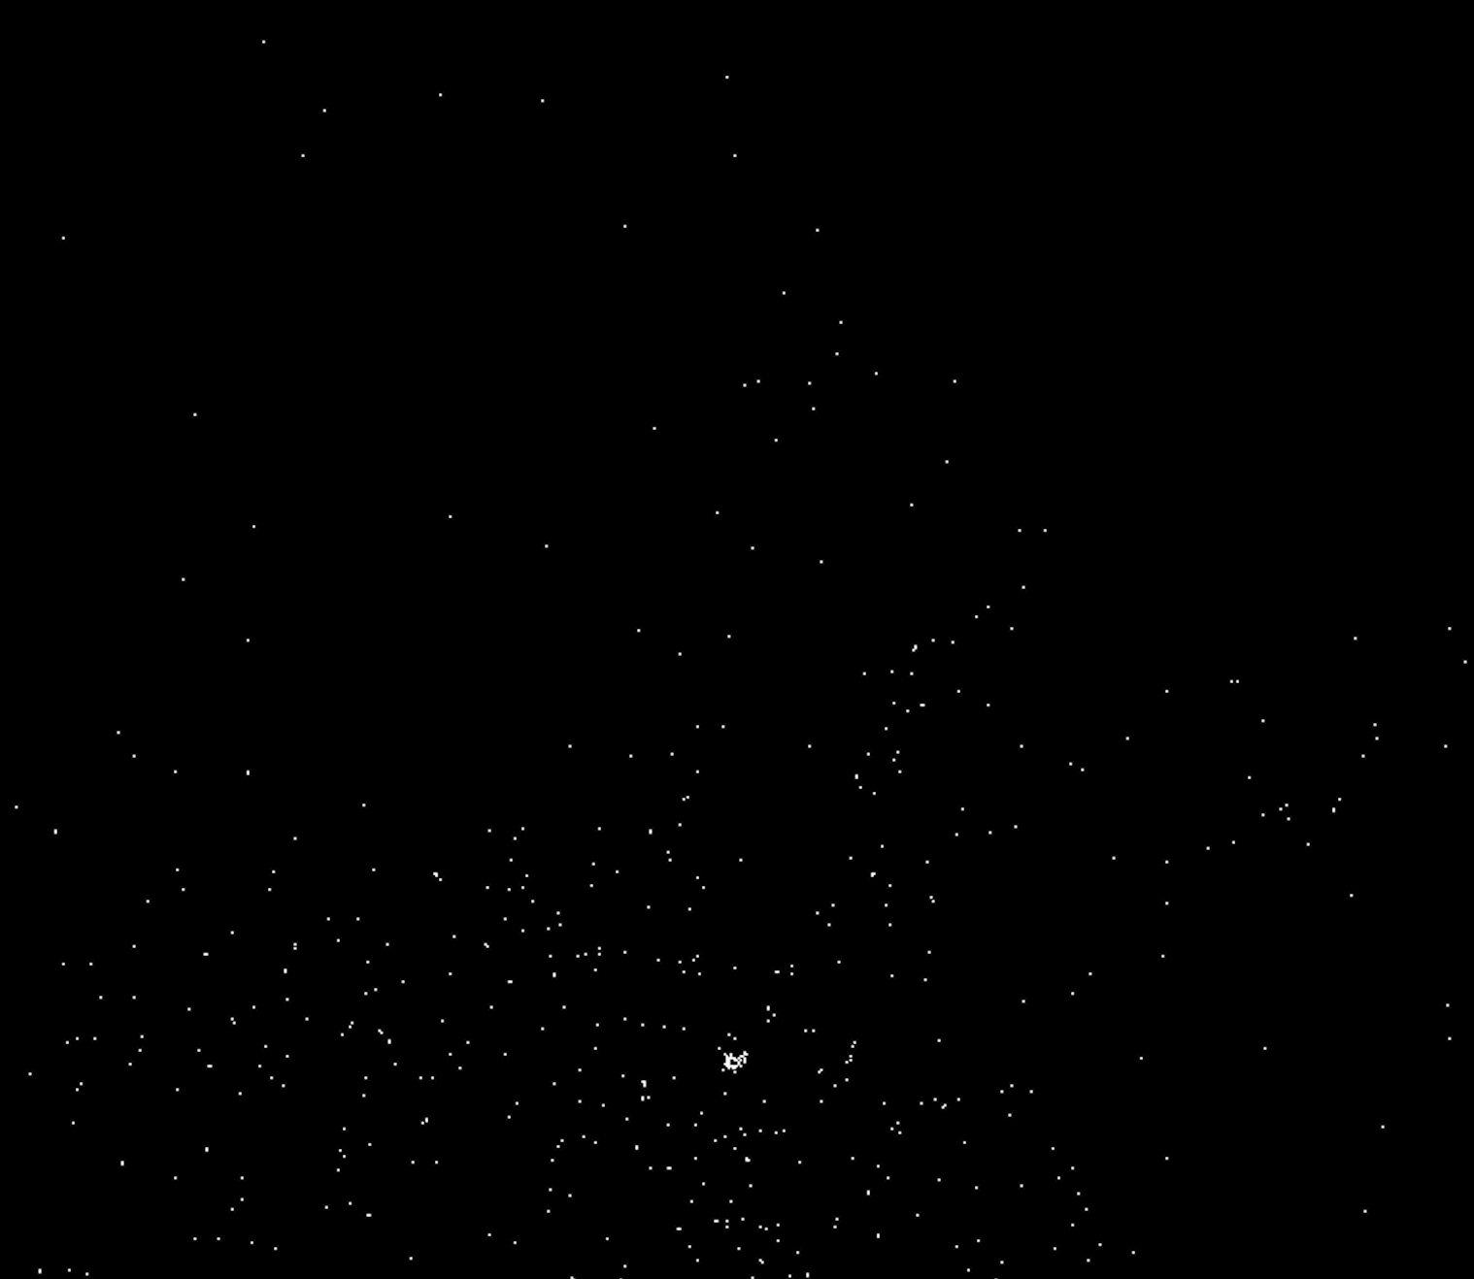
Blue Threshold
t = 50
t = 75
t = 100

Slide 6
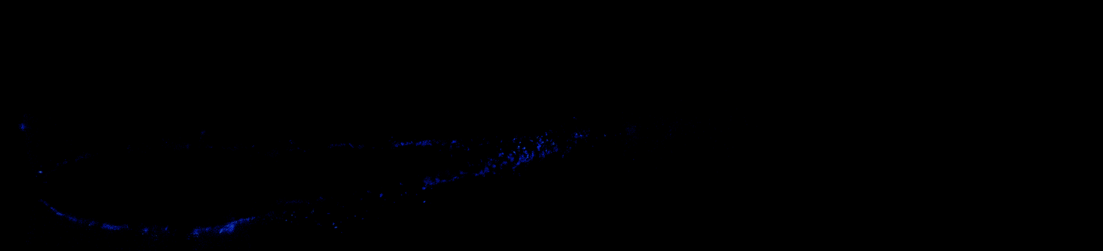
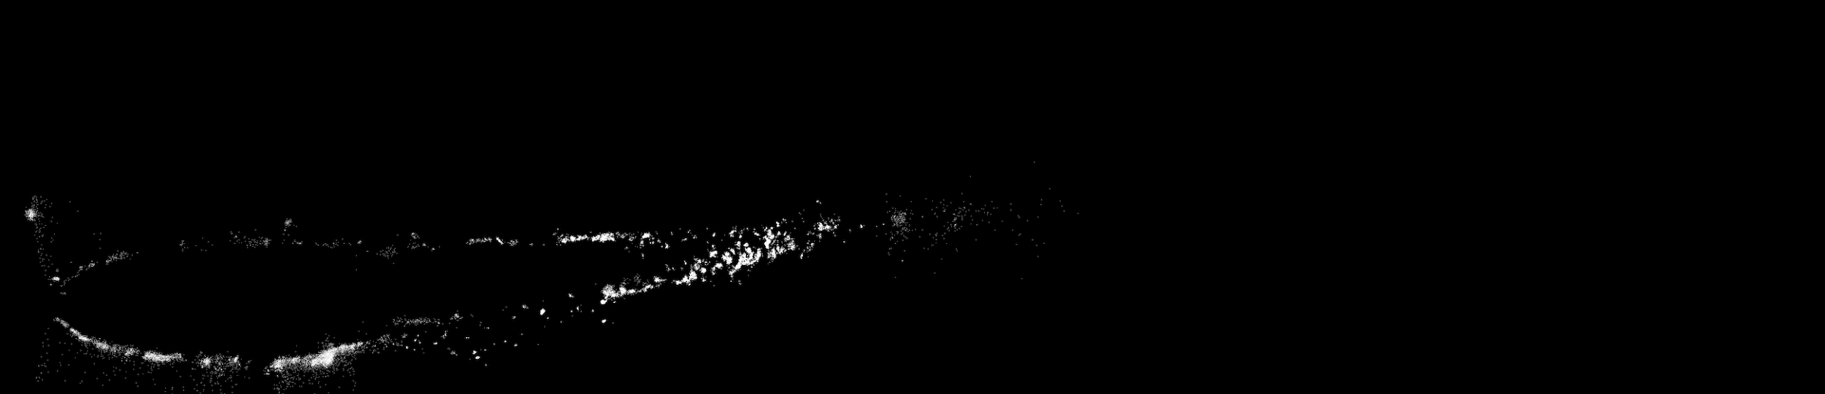
Mean and Standard Deviations

Slide 7
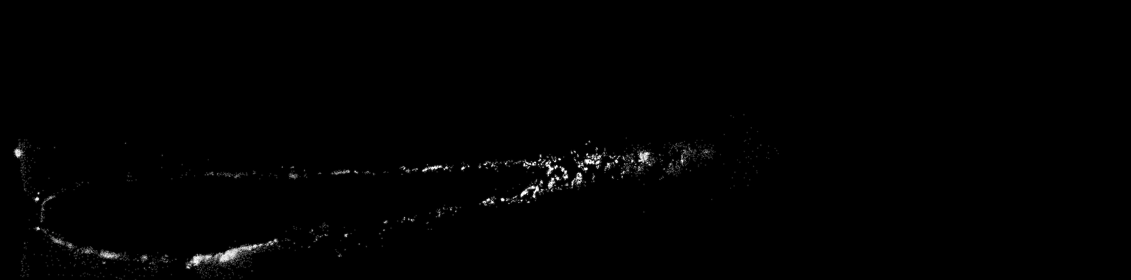
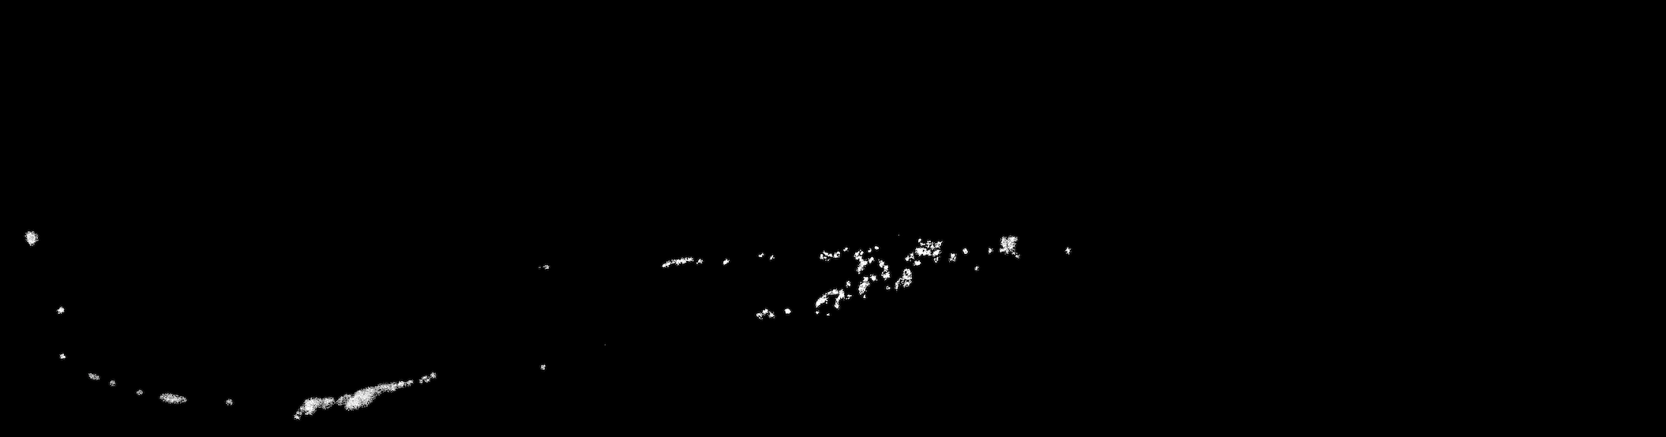
Average over pixel neighborhood

Slide 8
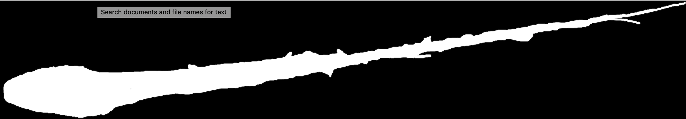
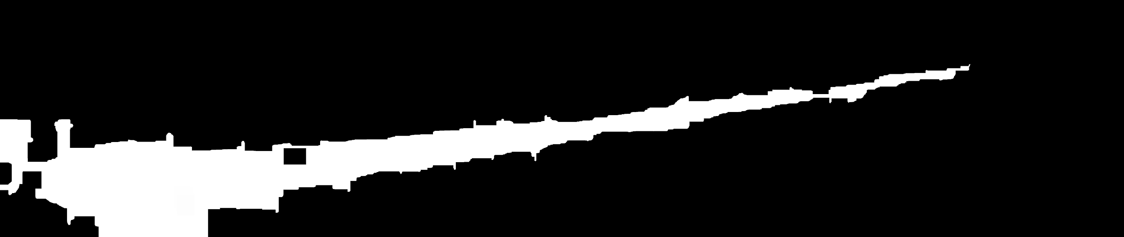
Defining+filling in the form -- stacking+closing
Ground truth manual outline
Automated pipeline output

Slide 9
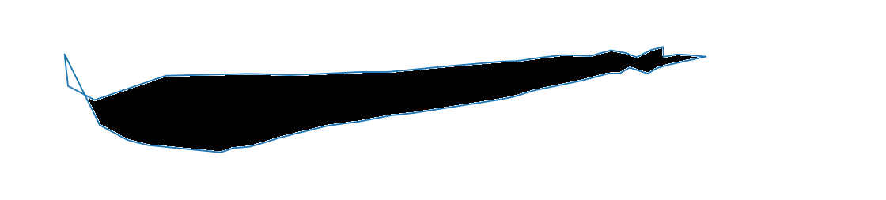
Defining+filling in the form -- tracing+flooding
Ground truth manual outline
Automated pipeline output

Slide 10
Solution - trail 1
Notes:
Metrics:
Penetration depth - measuring max dist between pixels
Skewness - distance between axis of entry and centroid of cross-sectional slices
Eccentricity -
Volume
Axial deviation

Slide 11
Solution - trail 2

Slide 12
Cross-sectional view

Slide 13
Next steps
Creating full sets of images for alternate views (e.g., cross-sections)
Fully-automating the existing pipeline
Tune parameters for better results
A light GUI for easy use
GPU for faster runs
Completing pipeline for automated measurements

